Slide 1

DOTA 2 COMPETITIVE PICKS
By: wafi

Slide 2
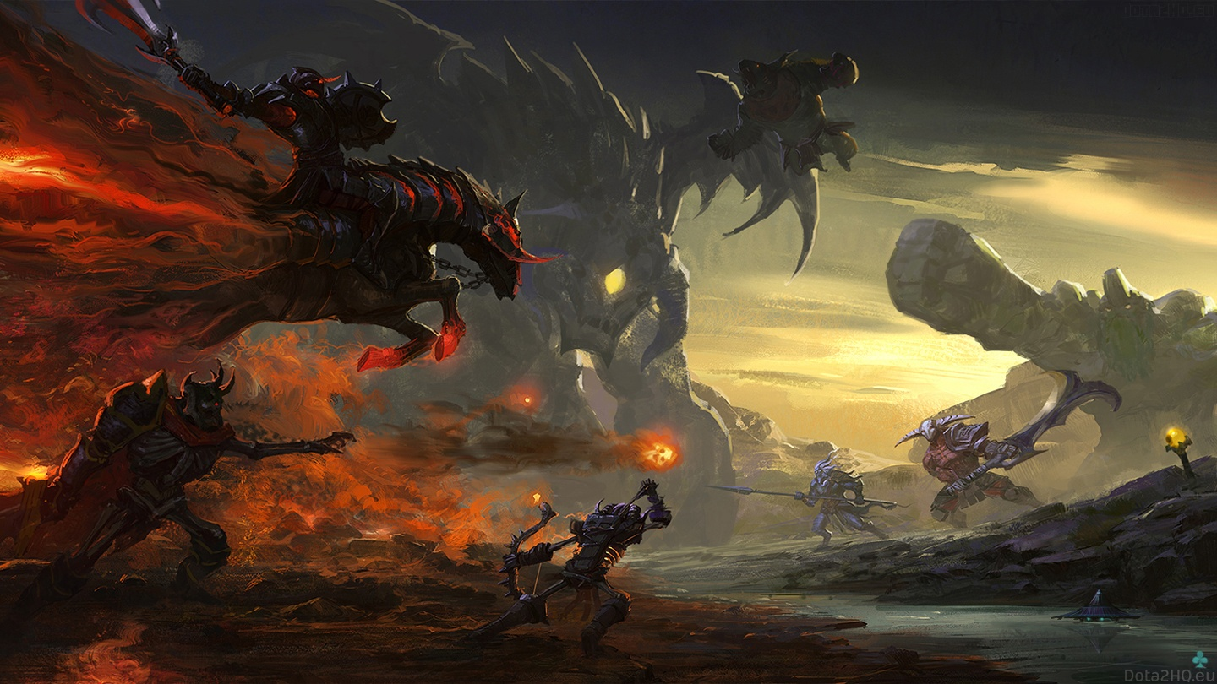

BACKGROUND
Dota 2 is a 5v5 game which each player controls a single hero who has a variety of skills that can be used to attack enemies, empower allies or increase one’s own strength.
The main objective in Dota 2 is to destroy the enemy base inside their stronghold.

Slide 3
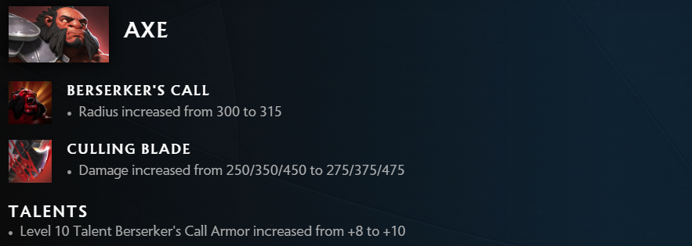
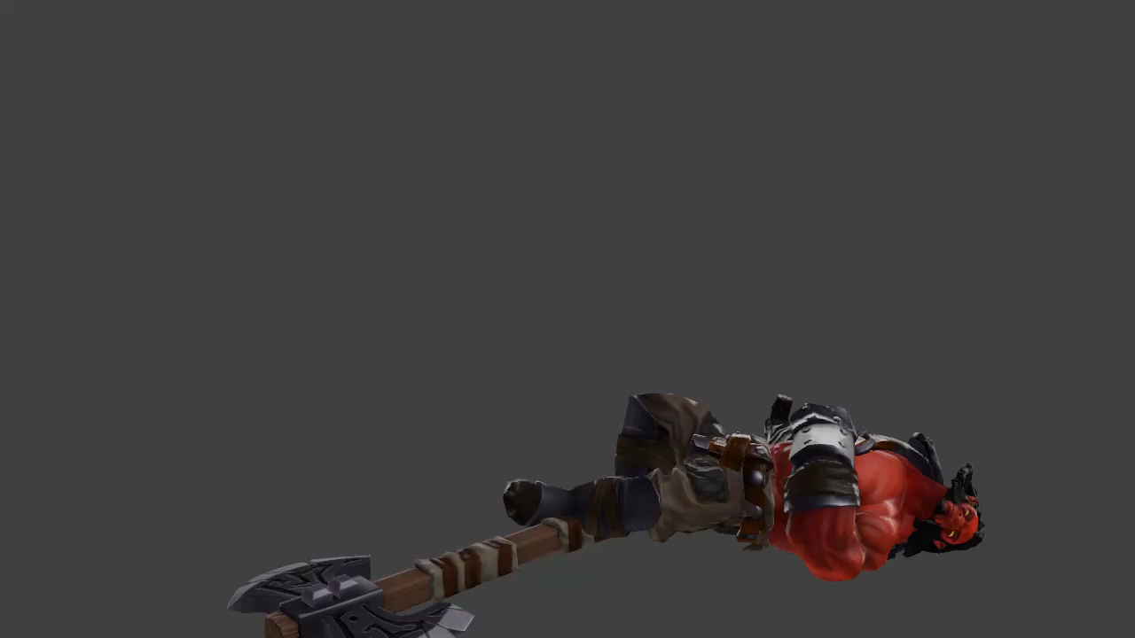


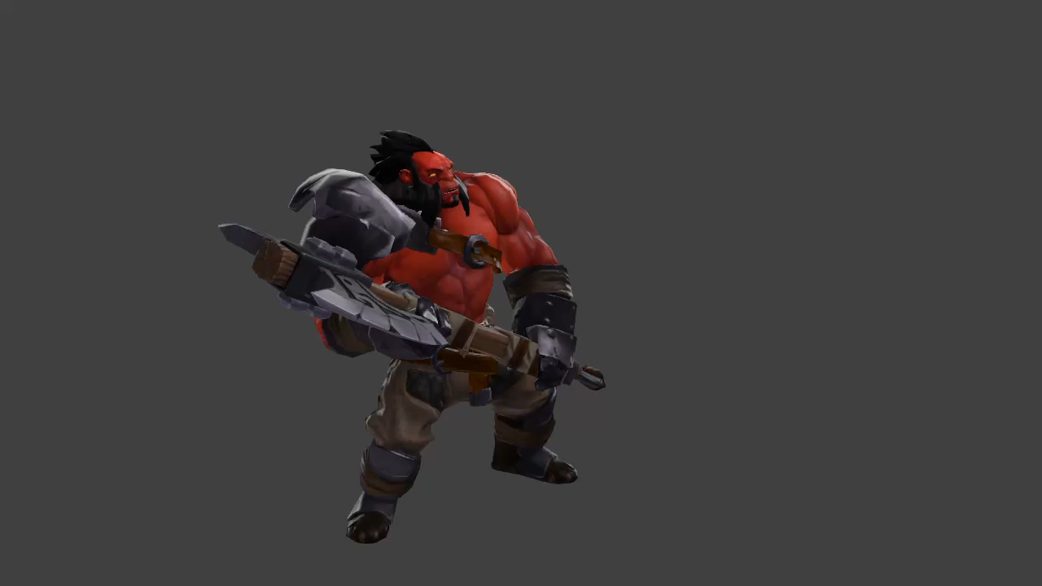
New patch bring changes to heroes, items, and mechanics
Weak
stronk
Before patch
After new patch

Slide 4
PROBLEM STATEMENT
As casual gamers, we may not possess the knowledge to comprehend how these patches affect the game playstyle and its meta (the most effective tactics available).
objective
By studying the hero picks within the professional gaming scene, we can gain insights into the meta and which powerful heroes provide us with the best opportunity to secure victories in our games.

